Slide 1
ME 161 Introduction to Mechanical Engineering Lec Note 2: Brig Gen Humayun
Please go through class notes and reference materials discussed in the class. This is just a guideline for those who missed the classes

Slide 2
Engine
a. A machine that converts energy into mechanical force or motion.
b. Such a machine distinguished from an electric, spring-driven, or
hydraulic motor by its use of a fuel.
Heat Engine
It can be defined as any engine that converts thermal energy to mechanical work output. Examples of heat engines include: steam engine, diesel engine, and gasoline (petrol) engine.
On the basis of how thermal energy is being delivered to working fluid of the heat engine, heat engine can be classified as an internal combustion engine and external combustion engine.
Heat Engine
External Combustion Engine
Internal Combustion Engine

Slide 3
Internal Combustion Engine (IC Engine)
Internal combustion engines are those engines
in which the combustion of fuel takes place inside
the engine cylinder.
Examples: Petrol, Diesel, Gas Engine
External combustion engine
Combustion of an air-fuel mixture transfers heat to a second fluid which becomes the motive (working) fluid that produces power.
Example: Steam driven engine

Slide 4
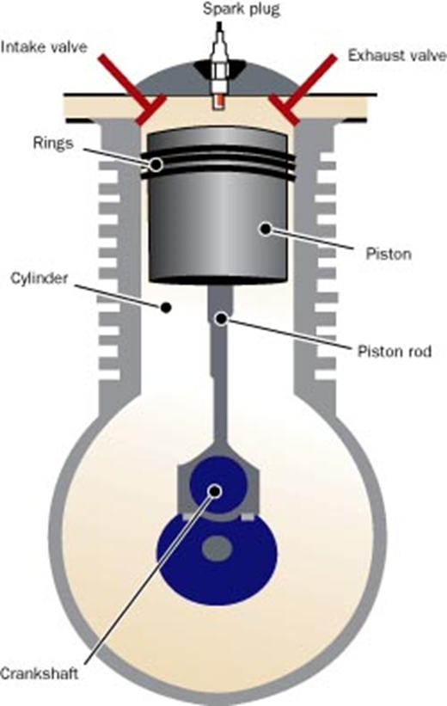
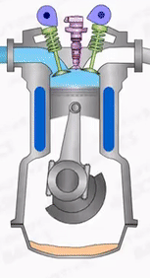
Classification of I.C. Engine
The internal combustion engine may be classified in many ways:
According to the type of fuel used :
Petrol Engine
Diesel Engine
Gas Engine
According to the method of ignition of fuel:
a. Spark ignition engines (SI engine)
b. Compression ignition engines (CI engine)

Slide 5
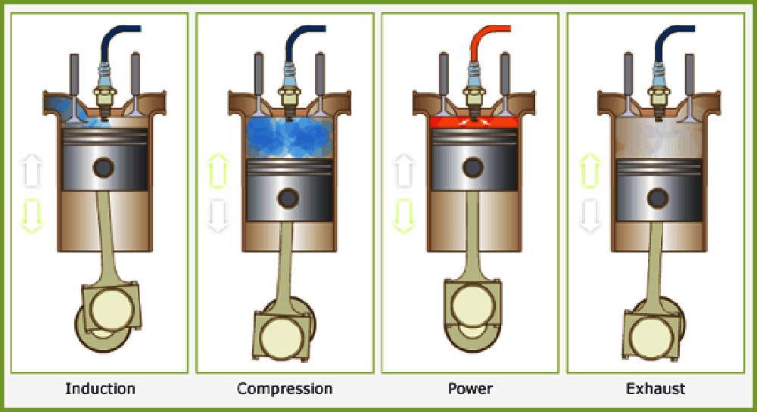
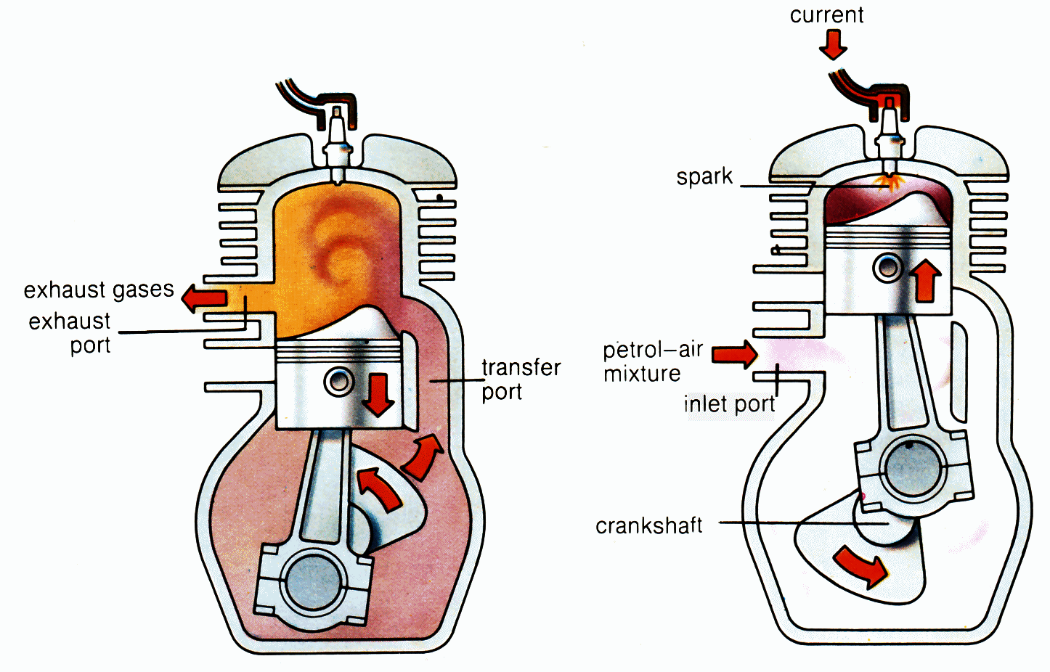
3. According to the number of strokes per cycle :
a. Four Stroke cycle engines
b. Two stroke cycle engines

Slide 6
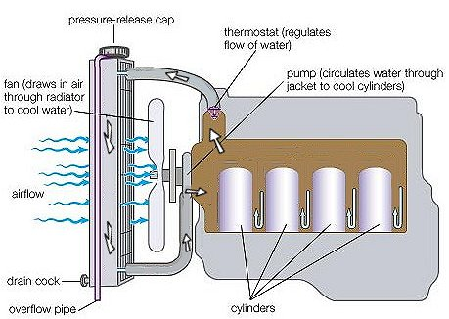
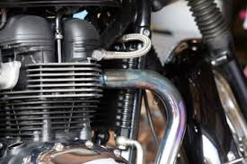
4. According to the speed of the engine :
a. Slow speed engines
b. Medium speed engines
c. High speed engines
5. According to the cooling system:
a. Air-cooled engines
b. Water cooled engines

Slide 7
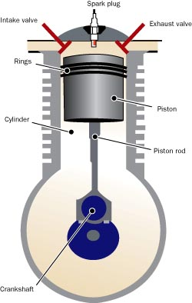
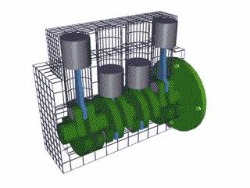
6. According to the number of cylinders:
a. Single cylinder engines
b. Multi-cylinder engines

Slide 8
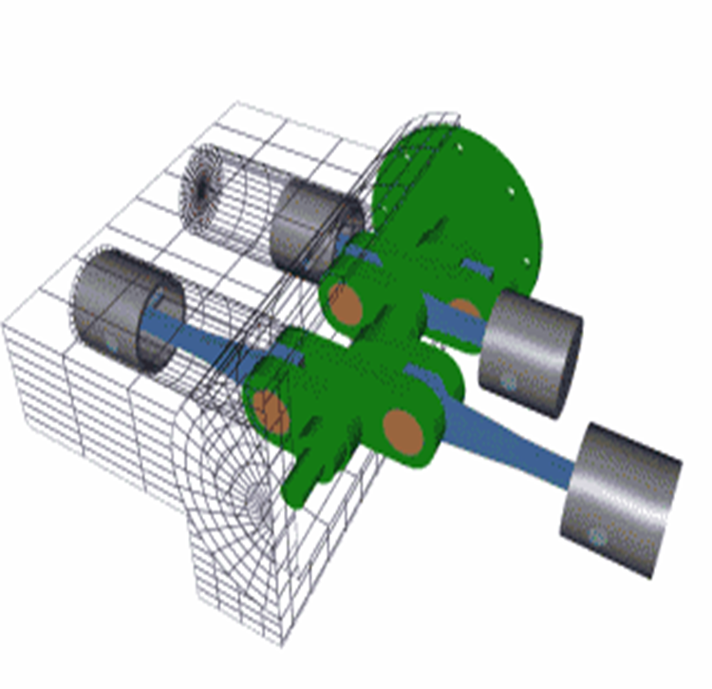
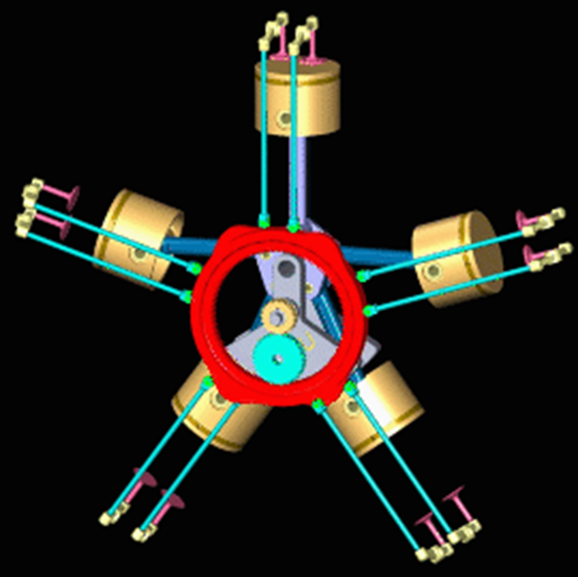
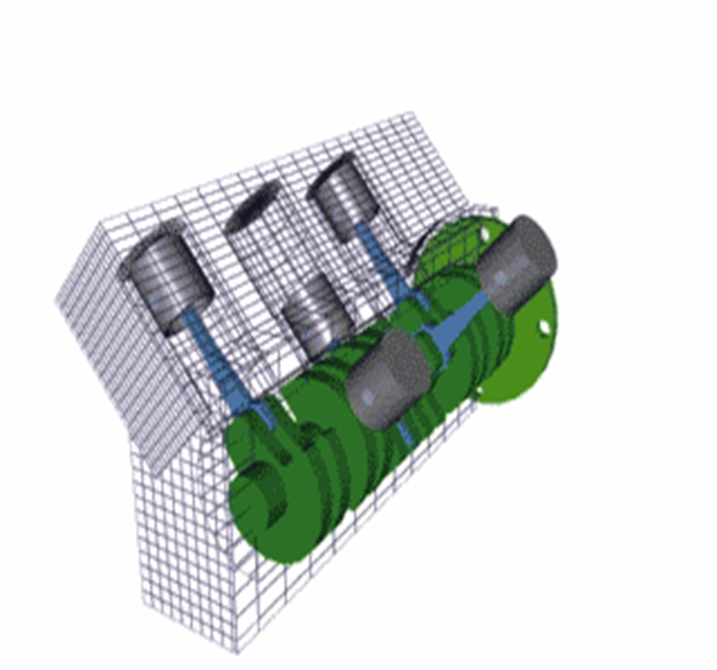

7. According to the arrangement of cylinders:
a. Vertical Engines
b. Horizontal Engines
c. Radial engines
d. V-type multi-cylinder engines
e. In-line multi-cylinder engines
b
c
d
e

Slide 9
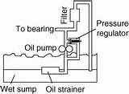
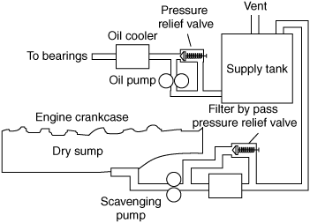
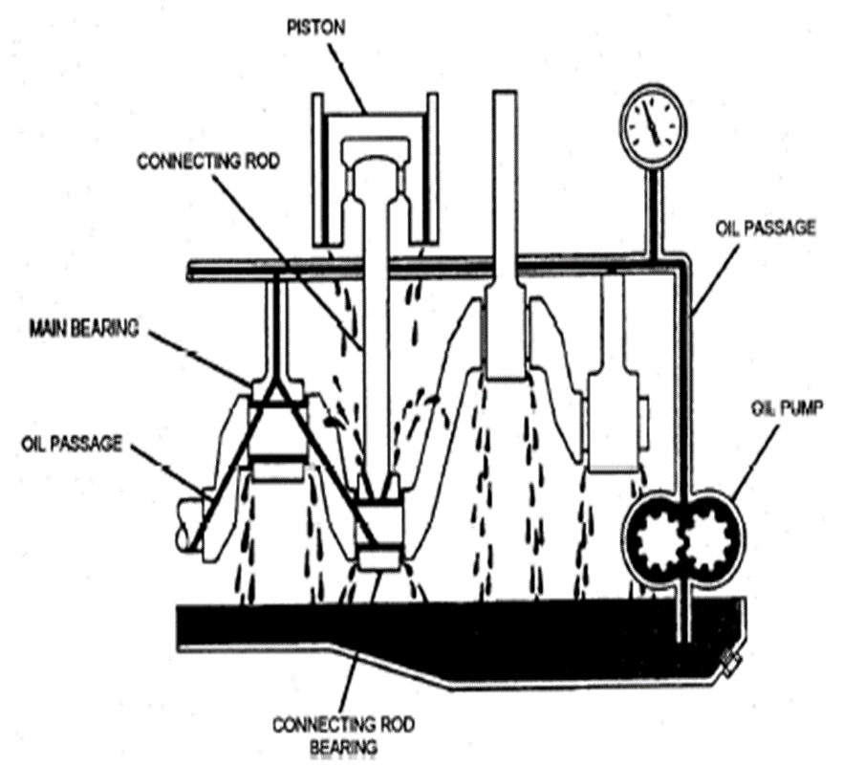
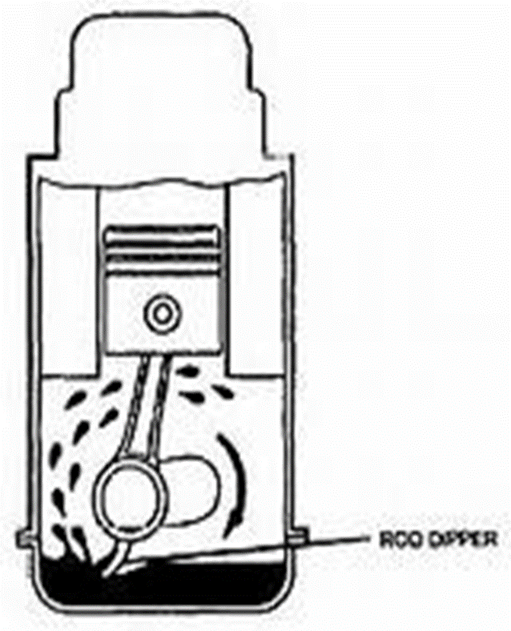
8. According to the type of lubricating system:
Wet sump lubrication
Dry sump lubrication
Pressure lubrication
Splash lubrication

Slide 10
9. According to the cycle of operation:
a. Otto cycle
Diesel cycle
Duel or mixed cycle

Slide 11
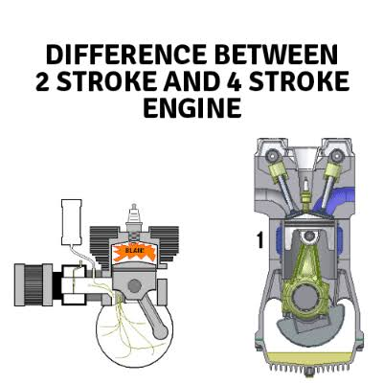
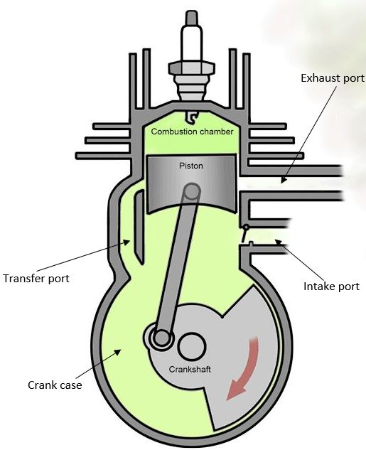
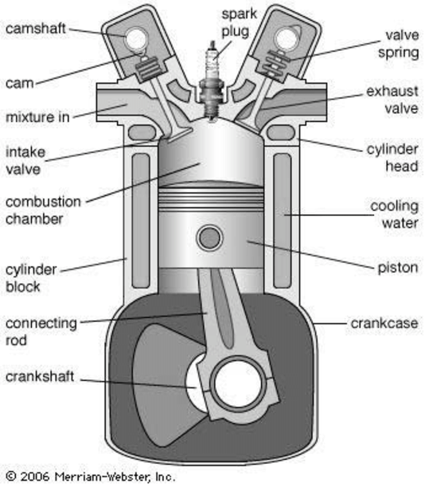

Slide 12
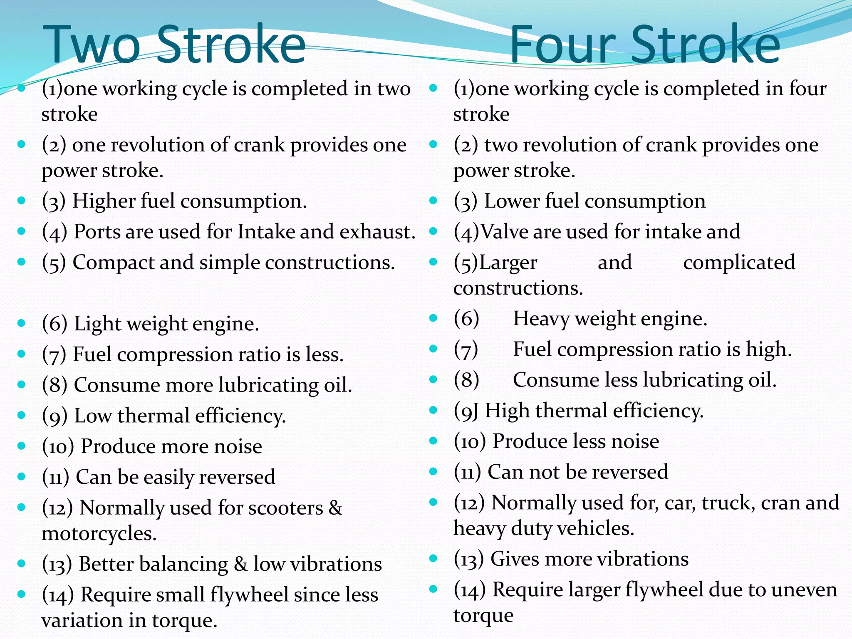

Slide 13
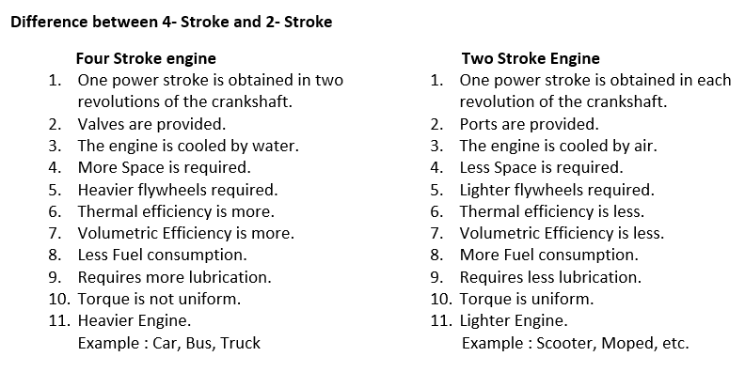
Comparison of 4 Stroke and 2 Stroke Engine

Slide 14
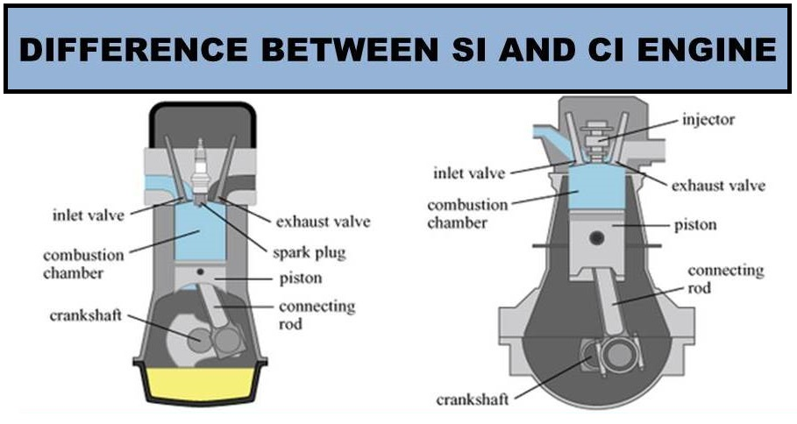
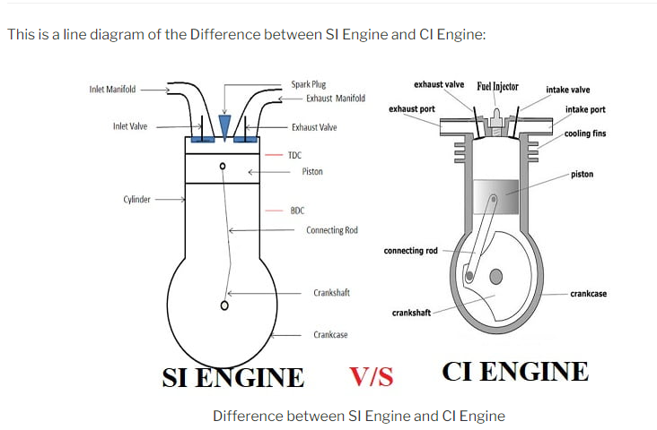

Slide 15
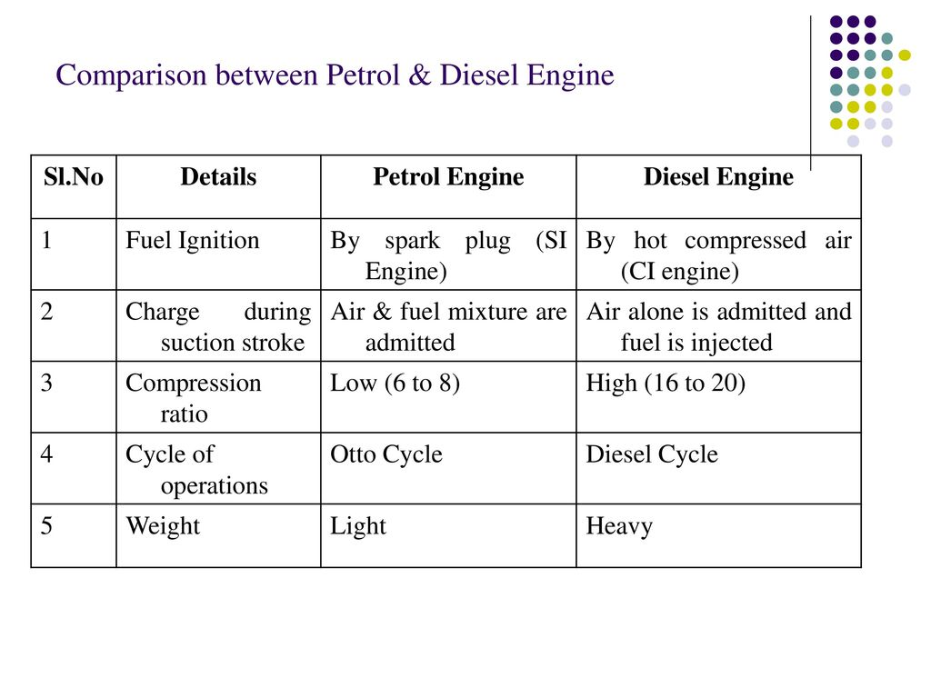

Slide 16
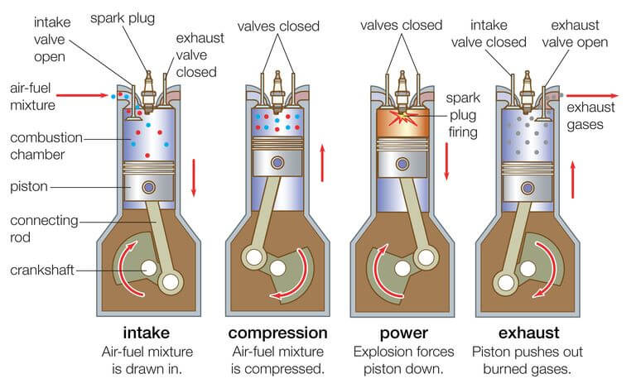
4 Stoke Internal Combustion Engine

Slide 17
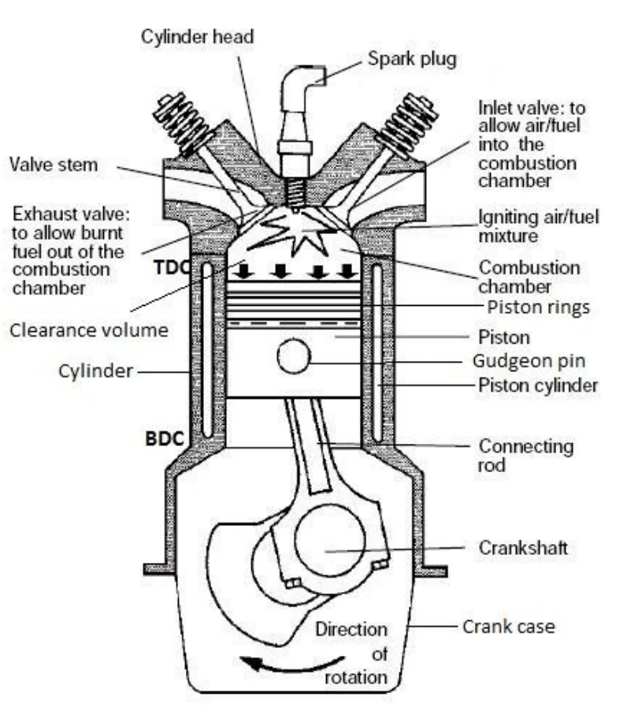
Basic Components of a 4 Stroke Engine
Cylinder, Cylinder Head, Piston, Piston Ring, Gudgeon pin or Piston Pin, Connecting Rod, Small End and Big End, Crank Shaft, Cam Shaft, Crank Case, Valves or Ports, Manifold, Push Rod, Rocker Arm, Spark Plug or Fuel Injector, Cooling Jackets or Fins, Flywheel

Slide 18
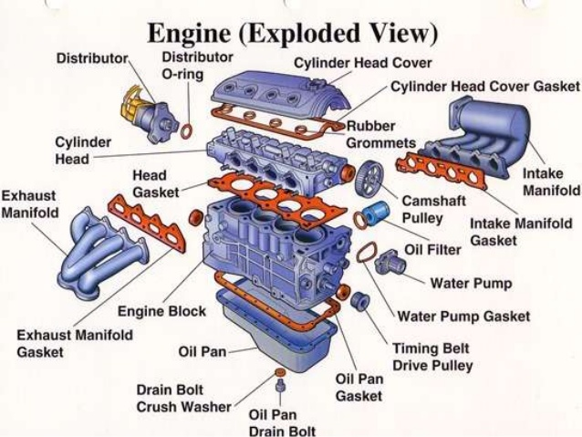

Slide 19
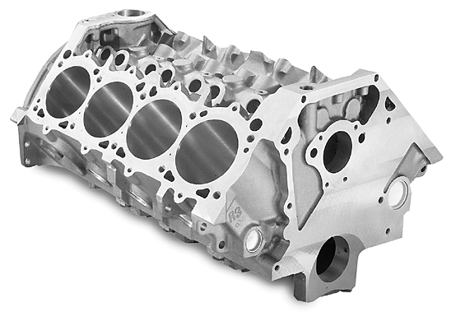
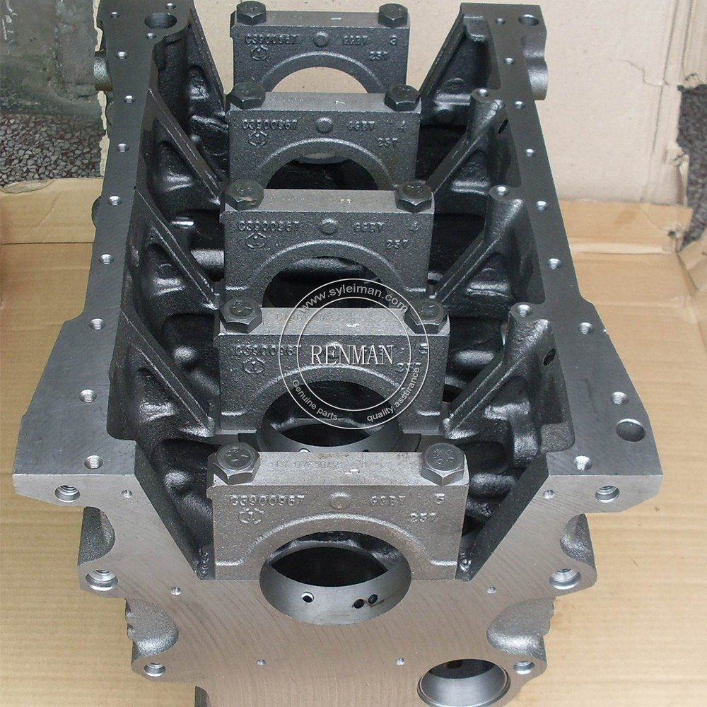
Main Components of I.C. Engine
Cylinder block: The cylinder block is the foundation of
the engine. Usually made of cast iron; Contains
coolant passages.

Slide 20
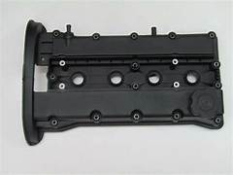
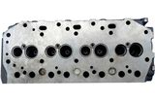
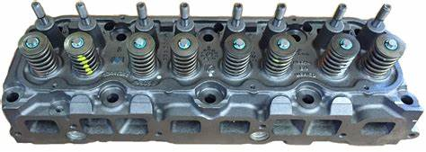
Cylinder head
The temperature of Engine Cylinder can be raised to 2600 degree centigrade.
Now a days cylinder blocks made of grey cast iron, compact graphite cast iron, nodular cast iron and cast Al alloy.
Cylinder Head:
The cylinder head is fitted over the Cylinder Block.
As of the cylinder block, the cylinder head is also made of same material [Cast Iron].
Generally, cylinder and cylinder head both are made by casting.
There are Valves [Inlet or Exhaust], Spark Plug [SI Engine] or Fuel Injector [CI Engine] are mounted on it.
A gasket is provided on the Cylinder Head to avoid the leakage of the compressed fuel and make the cylinder block air-tight.
The Functions of Cylinder Head:
In this chamber, the ignition of the charge [Air+Fuel] happens.
It guides the piston to reciprocates.
It is used for closing the Cylinder block.

Slide 21
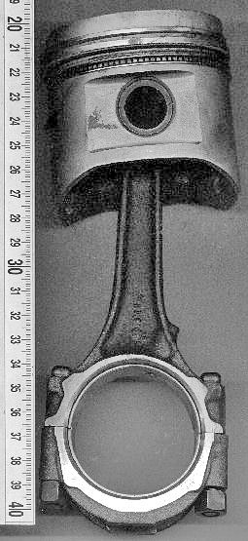
Piston
The piston is generally made of Aluminium Alloy, which is good for heat transfer.
The Functions of Piston:
Piston converts the to-fro motion or the reciprocating motion to the rotary motion.
A piston is also used to transfer the energy [after Power Stroke] to the connecting rod.
Gudgeon Pin or Piston Pin:
Gudgeon Pin is used to connect connecting rod with the piston.
It is made of Steel alloy to bear the high strength.
It is generally, made by forging process.

Slide 22
Piston Ring
Piston Ring:
Piston Rings are attached to the periphery of the Piston, generally made of steel alloys.
In an Internal Combustion Engine, three piston rings are used.
The top one is named the compression ring, and the bottom one is named the oil ring.
The Functions of Piston Rings:
The compression ring is used for preventing the leakage of burnt gases into the lower chamber.
Oil Ring is used for preventing the leakage of oil inside the engine block. Also, it scrapes the oil from the cylinder wall.
Lastly, the middle ring is for safety purposes if by chance the leakage of burnt gas or oil happened than it can prevent that.

Slide 23
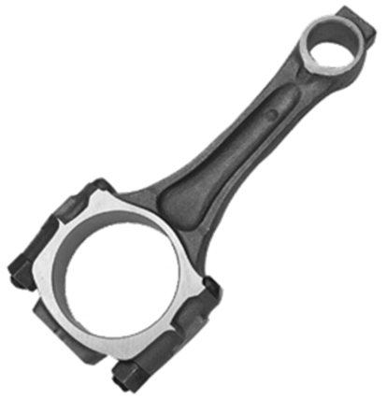
Connecting Rod
Connecting Rod:
Connecting Rod is generally used to transfer the reciprocating motion to the rotary motion of the crankshaft.
The one end [smaller] is connected with the Piston with the help of piston pin, and the other end [bigger] is connected with the crankshaft with the help of a crank pin.
Connecting rod is made of Steel
Alloy or Aluminium Alloy.

Slide 24
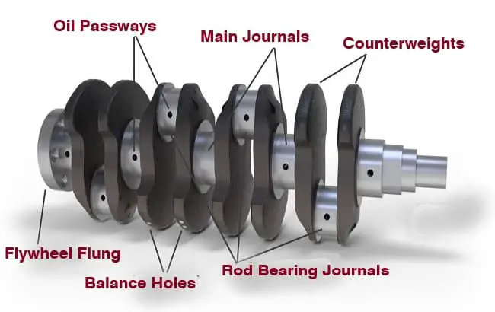
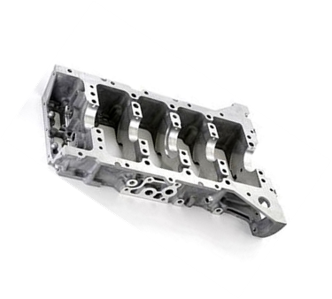
Crank Shaft
Crank Shaft:
This is the rotating member of an IC Engine which covert the reciprocating movement of the piston to rotary motion.
All the pistons of the engine are connected with the crankshaft by the help of connecting rod and one end of this crankshaft is connected with Flywheel. It is made of forged steel or Cast Iron.
The Functions of Crank Shaft:
The crankshaft converts the reciprocation movement of piston to the rotary motion.
It drives the flywheel and camshaft.

Slide 25
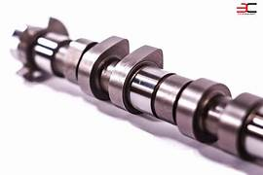
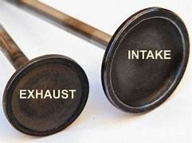
The Functions of the Cam Shaft:
It helps to open the poppet valves [Inlet and Exhaust] at the proper time.
The Functions of the Crank Case:
It protects the crankshaft and connecting rod from debris.
In some engines, the crankcase is used for sump of lubrication oil.
The Functions of Valves:
During suction stroke inlet valve allow the charge [Air+Fuel or only Air] to go inside the engine cylinder.
And after the exhaust stroke, through exhaust v/v the burnt gas is going out of the cylinder.
They also seal the piston-cylinder when compression stroke happens.

Slide 26
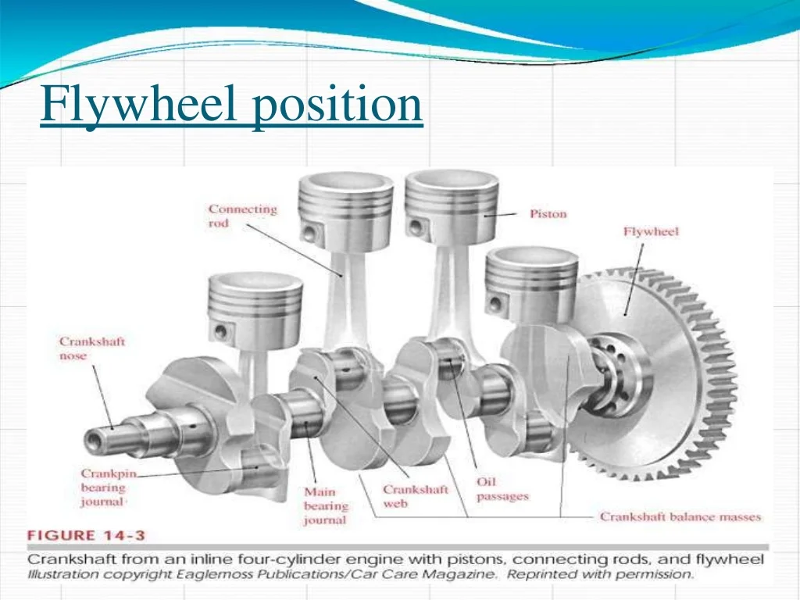
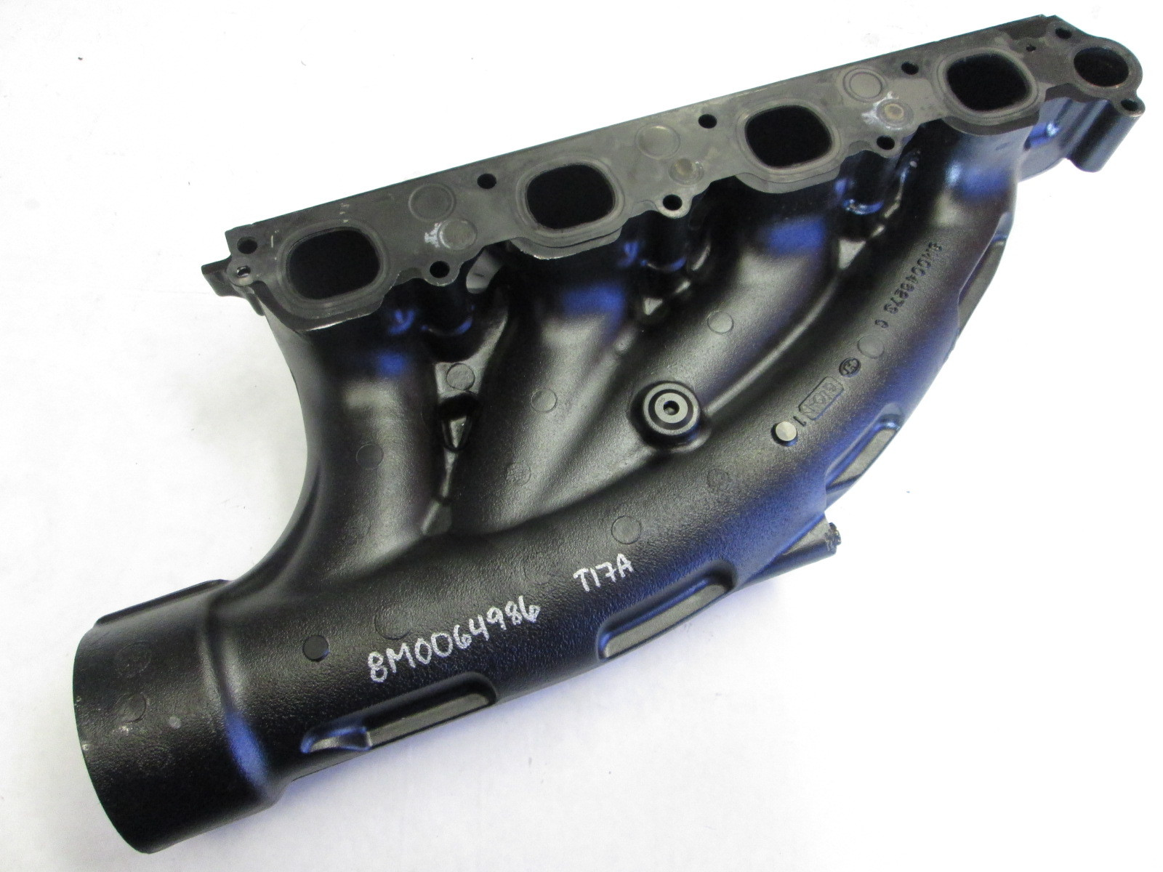
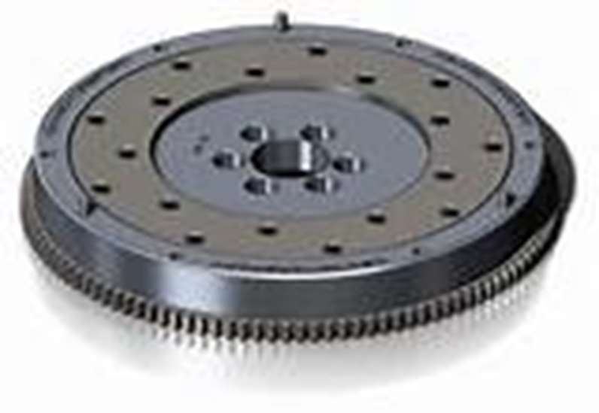
Functions of Manifolds:
Through the manifold, the fresh charge comes into the engine cylinder and brunt gases come out from the engine cylinder.
Functions of Cooling Jackets or Fins:
To reduce the temperature of the engine.
To protect the engine from wear and tear.
The Functions of Flywheel:
The main function of the flywheel is to store excess energy during the power stroke and supply that energy to the rest of the threes strokes to complete the cycle.

Slide 27
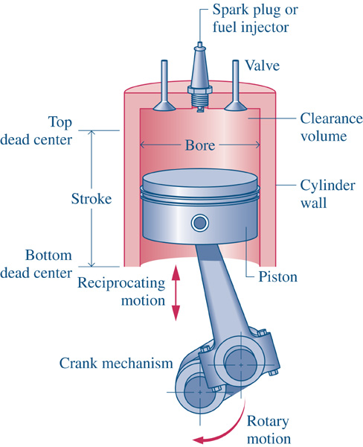
Engine Terminologies

Slide 28
Engine Terminologies
Top Dead Center (TDC): Position of the piston when it
Stops at the furthest point away from the crankshaft.
Top because this position is at the top of the
engines (not always), and dead because the piston
stops as this point
When the piston is at TDC, the volume in the
cylinder is a minimum called the clearance volume

Slide 29
Engine Terminologies
Bottom Dead Center (BDC): Position of the piston
when it stops at the point closest to the crankshaft.
Stroke: Distance traveled by the piston from one
extreme position to the other : TDC to BDC or BDC
to TDC.
Bore: It is defined as cylinder diameter or piston
face diameter; piston face diameter is same as
cylinder diameter( minus small clearance).

Slide 30
Engine Terminologies
Swept volume/Displacement volume : Volume
displaced by the piston as it travels through one
stroke.
Swept volume is defined as stroke times
bore.
Displacement can be given for one
cylinder or entire engine (one cylinder times
number of cylinders).

Slide 31
Engine Terminologies
Clearance volume: It is the minimum volume of the cylinder
available for the charge (air or air fuel mixture) when the piston
reaches at its outermost point (top dead center or outer dead
Center)during compression stroke of the cycle.Minimum volume
of combustion chamber with piston at TDC.
Compression ratio: The ratio of total volume to clearance
volume of the cylinder is the compression ratio of the engine.
Typically compression ratio for SI engines varies form 8 to 12
and for CI engines it varies from 12 to 24.

Slide 32
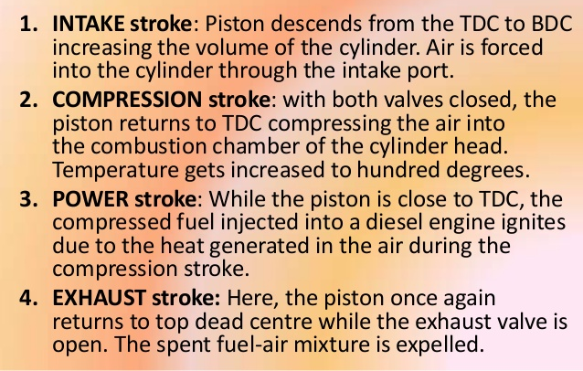
Sequence of operation of 4 Stroke Diesel (CI and SI)Engine

Slide 33
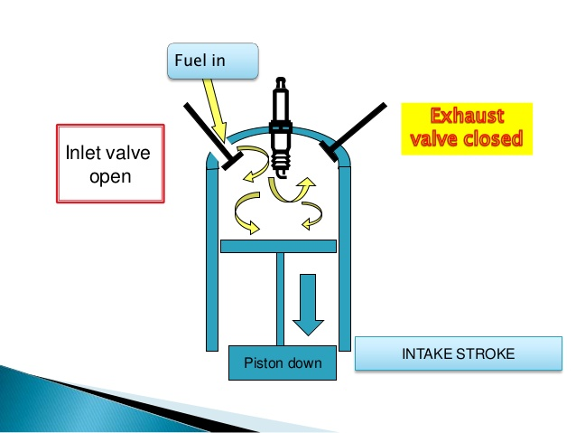
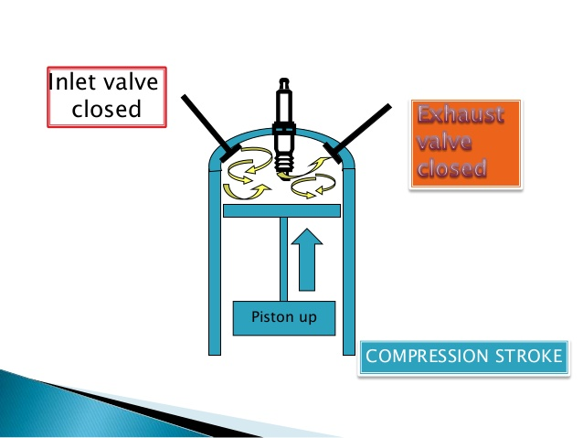
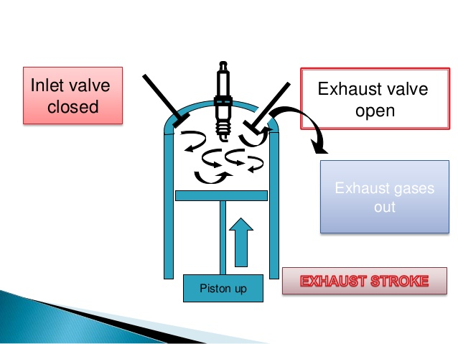
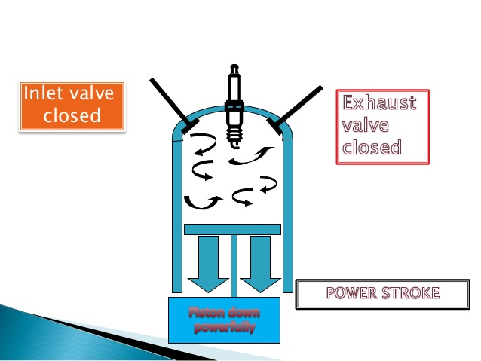
Sequence of operation of 4 Stroke Petrol (SI) Engine

Slide 34
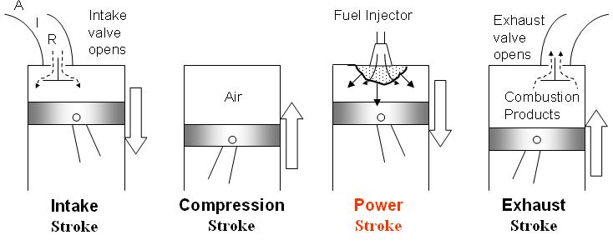
Sequence of operation of 4 Stroke Diesel (CI)Engine

Slide 35
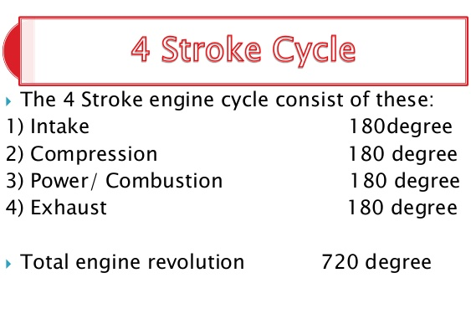

Slide 36
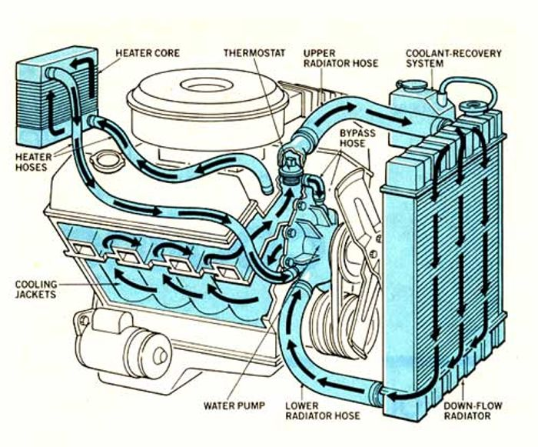
Cooling system of engine

Slide 37
How Does a Cooling System Work?
The coolant flows from the water pump, through the ways which are located inside the engine block. On its way it gathers the heat produced by the cylinders. After that it goes up to the cylinder head (or heads in a V type engine) where it collects the residual heat from the combustion chambers. Then the coolant makes its way to the thermostat in case the thermostat is opened to allow the fluid to pass. From there the coolant goes through the thin flattened tubes that make up the core of the radiator.
Inside there, the coolant is cooled by the air flow through the radiator. From here it flows out of the radiator by the lower radiator hose. It then goes back to the water pump. After this stage the temperature of the coolant is reduced and it can gather more heat from the engine. The capacity of a cooling system depends upon the engine. The cooling system for a bigger and powerful engine in a heavy vehicle will need high capacity than a compact car with a comparatively much smaller engine. In a bigger vehicle the radiator is bigger with numerous tubes for the coolant to flow through.

Slide 38

Components used in Water Cooling system
Radiator
Radiator Cooling Fans
Pressure Cap & Reserve Tank
Water Pump
Thermostat
Bypass System
Water jacket
Head Gaskets & Intake Manifold Gaskets
Heater Core
Hoses
Coolant Temperature Sensor (CTS)
Coolant (Antifreeze + Water).

Slide 39
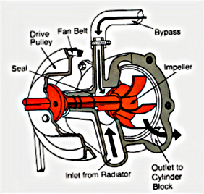




Slide 40


Thermostat Valve
Thermostat is a device (valve) used to determine the temperature of the coolant. If the coolant is hot enough, the thermostat opens to allow the coolant to flow through the radiator. When the coolant is not of high temperature then the flow to the radiator is constrained. In such condition, there is a provision of a bypass system. The fluid goes to the bypass system and gets back to the engine.
This system is important as it maintains the constant and continuous flow of coolant throughout the engine. This continuous flow maintains the temperature and eradicates the formation of hot spots. When the flow to the radiator is choked, optimum operating temperature of the engine is achieved sooner. This will aid in a cold day by allowing the heater to start supplying high temperature air to the inside very fast.

Slide 41
Cooling System- Water Cooling
Radiator
Water Pump
Water Jacket of Cylinder Block
Oil Cooler
Water Jacket of Cylinder Head
Thermostat housing
Thermostat bypass
An automotive cooling system must perform
several functions
a. Remove excess heat from the engine
b. Maintain a consist engine temperature
c. Help a cold engine warm-up quickly
d. Provide a means of warming the passenger compartment

Slide 42



Slide 43



Lubricating System Parts
Oil pan/sump
Oil strainer
Pick-up screen
Oil pump
Pressure regulator
Oil filter
By-pass valve
Oil galleries
Dipstick
Oil Pressure sending unit
Pressure indicator
Positive Crankcase ventilation Valve

Slide 44



Reduce wear

Slide 45
A good lubricant generally possesses the following characteristics:
A high boiling point and low freezing point (in order to stay liquid within a wide range of temperature)
A high viscosity index
Thermal stability
Hydraulic stability
Corrosion and Rust Inhibitor
Corrosion prevention
A high resistance to oxidation

Slide 46
Lubricating System
Big end bearings , connecting rod , small end bearings , Piston rings
Pressure Relief Valve
By Pass Valve
Crank shaft
Cam
shaft
Rocker arm , valve and valve spring
Sump
Strainer
Oil Pump
Filter
Oil Cooler
Main oil gallery
Timing gear mechanism
Sump

Slide 47

Fuel System

Slide 48
Fuel System
Residual diesel
Fuel tank
PrimaryFilter
Fuel feed pump/l low pressure pump
Secondary Filter
Fuel injection pump/ high pressure pump
HP line
Injector
Cylinder
Excess fuel

Slide 49


Super Charger

Slide 50


Turbocharger with intercooler working principle

Slide 51



Slide 52
Engine Power
Power = work / time
P= w/t
Hp = 33,000 ft-lb (work) / 1 minute (time)
Hp = 550 ft-lb / 1 second
Kinds of HP
Indicated Horsepower
Brake Horsepower
Frictional Horsepower
Rated Horsepower
Corrected Horsepower

Slide 53
Indicated Horsepower. The power developed within a cylinder can be calculated by measuring the imep and the engine speed. (The rpm of the engine is converted to the number of power strokes per minute.) With the bore and stroke know (available in engine manufacturers’ technical manuals), the horsepower (hp) can be computed. This power is called indicated horsepower (ihp) because it is obtained from the pressure measured with an engine indicator. Power loss due to friction is not con- sidered in computing ihp.
ihp = P × L × A × N /33,000
P = Mean indicated pressure, in psi L = ength of stroke, in feet A = Effective area of the piston, in square inches
N = Number of power strokes per minute
33,000 = Unit of power (one horsepower), or foot pounds per minute.

Slide 54
Brake horsepower. Actual or useful horsepower of an
engine, usually determined from the force exerted on a
friction brake or Dynamometer connected to the drive
shaft.
Frictional horsepower. That part of the gross or indicated
horsepower developed in an engine cylinder which is
Absorbed in frictional losses; It is the difference between
the indicated and the brake horsepower.
Rated horsepower. Power of an engine or prime mover,
The maximum horsepower that can be provided under
normal, continuous operation.
Corrected horsepower. is the observed readings
"corrected" to standard temperature, humidity, and
barometer, conditions.

Slide 55
Factors Affecting Engine Performance
Detonation. The explosion of the fuel/air mixture instead of a steady burning. This explosion causes an abrupt rise in cylinder temperatures and pressures that may cause engine damage .
Detonation may be caused by several factors:
low octane fuel (SI Engine)
high cylinder temperatures
lean/uneven mixture
high compression ratios
shape of combustion chamber and position of sparking plug
Preignition of the fuel/air mixture before the properly timed injection /spark occurs
Effect of Detonation:

Slide 56
Fuel Rating
Octane number, also called Antiknock Rating, measure of the
ability of a fuel to resist knocking when ignited in a mixture with
air in the cylinder of an internal-combustion engine.
The octane number is determined by comparing, the knock
intensity of the fuel with that of blends of two reference fuels:
iso-octane, which resists knocking, and heptane, which knocks
readily. Thus the octane number is the percentage by volume of
Iso-octane in the iso-octane–heptane mixture that matches the
Fuel being tested in a standard test engine.

Slide 57
Fuel Rating
cetane number. Measure of the ignition quality of
Diesel fuel; higher this number, the easier it is to start a
standard (direct-injection) diesel engine. It denotes the
percentage (by volume) of cetane (chemical name
Hexadecane) in a combustible mixture (containing
cetane and 1-methylnapthalene) whose ignition
characteristics match those of the diesel fuel being
tested.

Slide 58


HYBRID VEHICLE
EV
MILD HYBRID

Slide 59


Slide 60



Series, Parallel, Series-Parallel Hybrid Veh
Series
Parallel
Series-Parallel

Slide 61

Hybrid vehicle drivetrain

Slide 62


Slide 63
Benefits of Using Hybrid Car
Fewer Oil Changes. Since hybrid cars use less gasoline to run, they also require fewer oil changes, which means you'll save more on vehicle maintenance costs
Fuel Economy
Environmentally Friendly. No Idling
Less noise pollution
Overall level of dependence on fossil fuels will be lower. May help to protect our natural resources
Smaller Engines
Smart Features
Require Less Maintenance
Safety Features
Immediate Torque
Tax Incentives

Slide 64
Disadvantages of Hybrid Veh
They still imply some level of pollution
High purchase price of hybrid cars
Significant maintenance costs related to hybrid cars
May be hard to find a knowledgeable mechanic
More complex computer controlled system
Extra weight of batteries reduces fuel efficiency
Battery replacement can be expensive
Battery disposal implies additional waste
High-voltage batteries can be dangerous
Top speed may be rather limited
Entirely electric cars may be more eco-friendly but have a rather confined range.
Low performance at very high and low temperature
Also electric energy is not entirely green yet

Slide 65



Slide 66



Slide 67

Electronic fuel injection (EFI) system

Slide 68


Component of exhaust system

Slide 69

Function of Catalytic converter
A catalytic converter is an exhaust emission control device that converts toxic gases and pollutants in exhaust gas from an internal combustion engine into less-toxic pollutants by catalyzing a redox reaction.
Catalytic converters are usually used with internal combustion engines fueled by gasoline or diesel, including lean-burn engines.
"two-way" converters combine oxygen with carbon monoxide (CO) and unburned hydrocarbons (HC) to produce carbon dioxide (CO₂) and water (H₂O).
"three-way" converters that also reduce oxides of nitrogen (No_{x})

Slide 70


Slide 71


Slide 72

What Is A Speed Sensor?
A vehicle speed sensor (VSS) is a small component mounted on your car’s transmission that lets the car’s onboard computer know how fast you’re moving.
It’s also known as a wheel speed sensor, transmission speed sensor, or output shaft speed sensor.
How does the speed sensor work?
The vehicle speed sensor measures the rotational speed of the gears in your transmission system. Then, it converts this measurement into an analog signal or a low voltage square wave signal and relays it to electronic control units (ECUs) inside your car.
In turn, the ECUs use this signal to adjust your car’s speedometer readings, the ABS module, and transmission system.
Your car’s cruise control system may also rely on data generated by the speed sensor. Without it, your car wouldn’t be able to maintain a constant vehicle speed.

Slide 73

How does clutch system in car works
It transmits engine power to the gear box, and allows transmission to be interrupted while a gear is selected to move off from a stationary position, or when gears are changed while the car is moving.
When a car is moving under power, the clutch is engaged. A pressure plate bolted to the flywheel exerts constant force , by means of a diaphragm spring, on the driven plate .

Slide 74


Transmission gear box
Manual transmission also known as “Gearbox” is a type of transmission system. It is used in motor vehicles, which converts the torque and speed available from the engine and transmits the power to the wheels.

Slide 75


Differential
Differential gear, in automotive mechanics, gear arrangement that permits power from the engine to be transmitted to a pair of driving wheels, dividing the force equally between them but permitting them to follow paths of different lengths, as when turning a corner or traversing an uneven road.

Slide 76


Transmission of power engine to wheel in automobile

Slide 77




Slide 78


Fluid coupling/Torque converter
Fluid coupling is also known as hydraulic coupling. It is a hydrodynamic device which is used to transfer rotational power from one shaft to another by the use of transmission fluid. It is used in the automotive transmission system,
A torque converter is a type of fluid coupling that transfers rotating power from a prime mover, like an internal combustion engine, to a rotating driven load. In a vehicle with an automatic transmission, the torque converter connects the power source to the load. It is usually located between the engine's flexplate and the transmission. The equivalent location in a manual transmission would be the mechanical clutch.

Slide 79

Components of a brake system
The function of vehicle brake system is to stop or slow down the moving motor vehicle or prevent it from moving when in stationary position. All the braking systems use the force of friction for their operation. Friction opposes the relative motion of the bodies that are in contact with each other.

Slide 80

Components of steering system
The basic aim of steering is to ensure that the wheels are pointing in the desired directions. This is typically achieved by a series of linkages, rods, pivots and gears.

